Slide 1
Dynamic Zoom
Real-time Super Resolution for Videos
Baby Zoomers:
Shantanu Vichare, Dario Placencio, Nico Ranabhat, Hemanth Sridhar Nakshatri
CS 766 - Computer Vision
University of Wisconsin-Madison
Notes:
Introduction: Introduce your team (members and group name as seen on canvas).
Presentation Tips
- Practice your presentation multiple times to ensure smooth delivery within the time limit.
- Use clear and concise language. Use visuals and demo examples to explain more complex concepts.
- Time management is important. We will have to cut off presentations at the 10 minute mark, to ensure everyone gets equal time.
Evaluation Criteria
Presentations will be evaluated based on clarity, organization, technical content, creativity, and the ability to answer questions effectively.

Slide 2
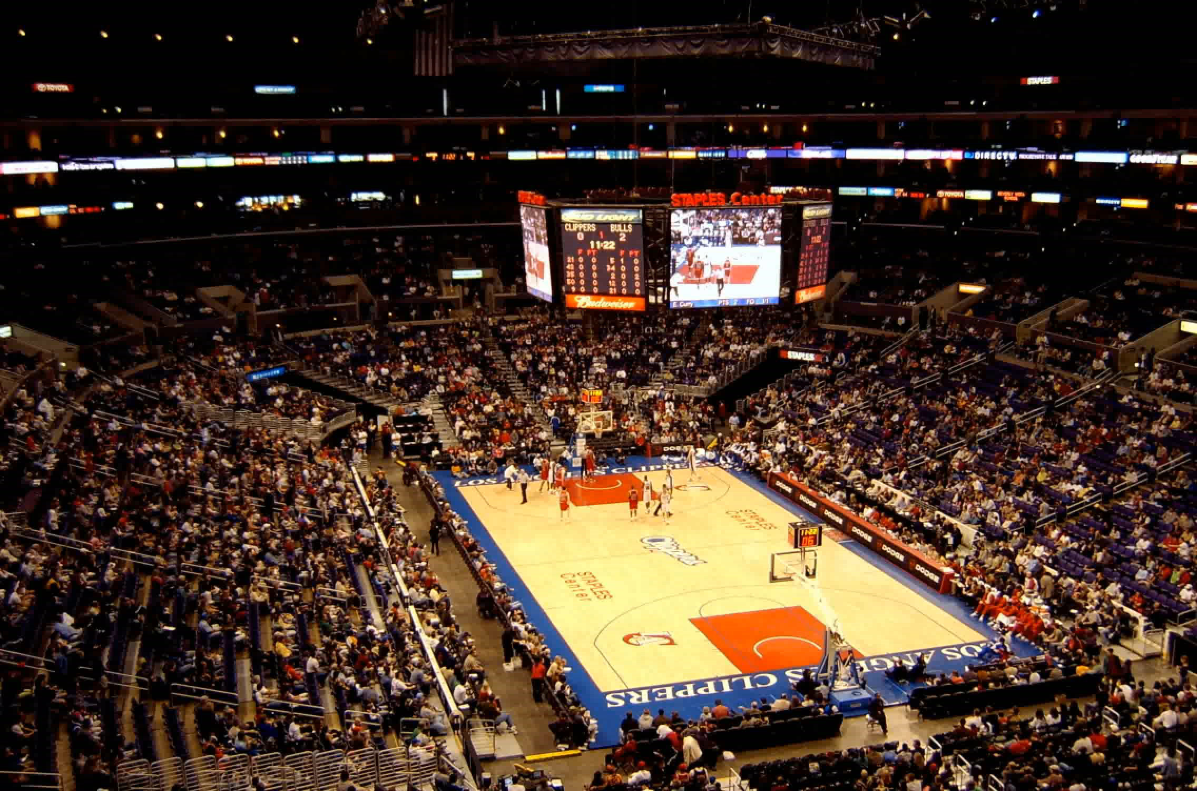
Outline
Problem statement
Methodology
Results
Conclusion
QnA

Slide 3
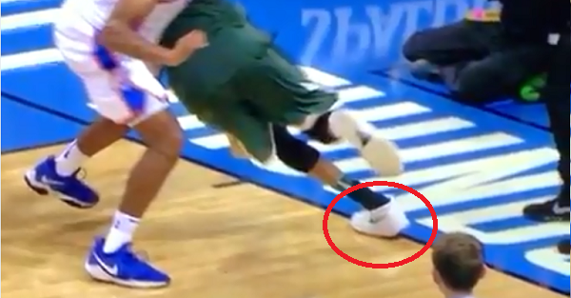
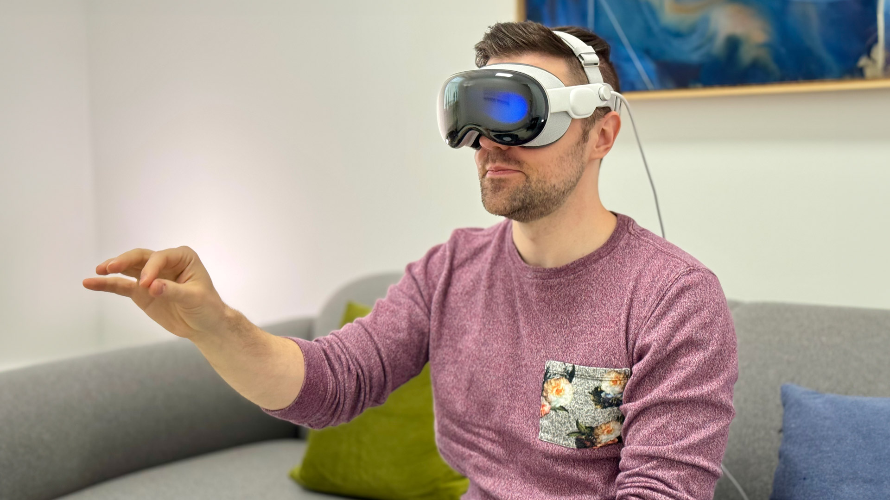
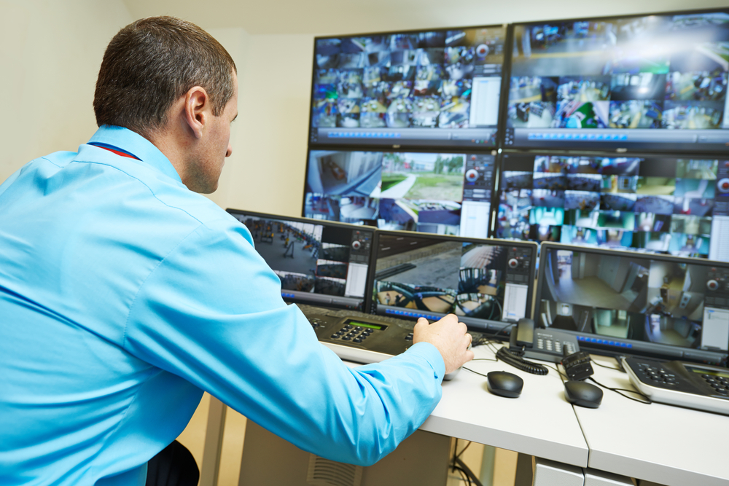
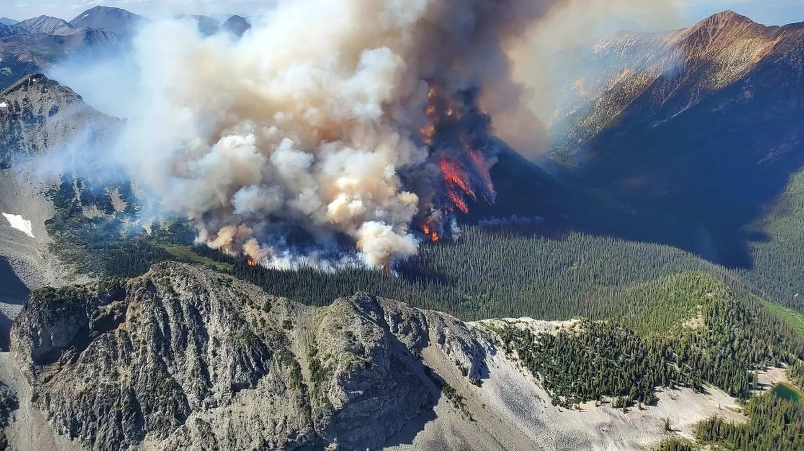
Motivation
Slow-motion sports video analysis
Augmented Reality
Security and surveillance
Search and Rescue

Slide 4
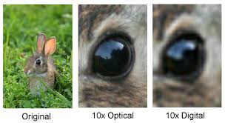
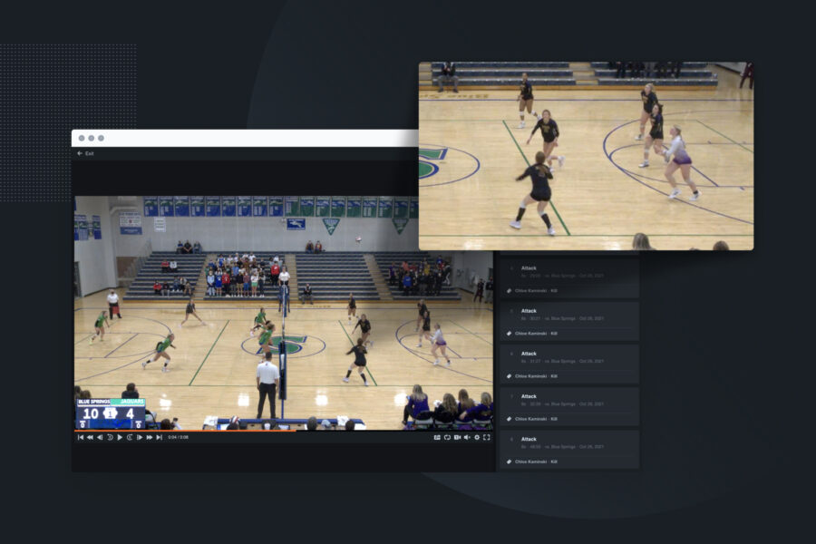
Challenges and Objective
Image degradation, such as pixelation, occurs when digital zoom exceeds a media’s native resolution.
Current SR methods are too slow for real-time processing
We aim to enhance image clarity during zoom with a real-time super-resolution method that also reduces computational load by focusing on key ROIs.
Notes:
Problem Statement and Background (2/3 min):
- Clearly define the problem or the objective of your project. Highlight the main challenges.
- Provide an overview of existing solutions or related work in the field. How do they address those challenges.

Slide 5
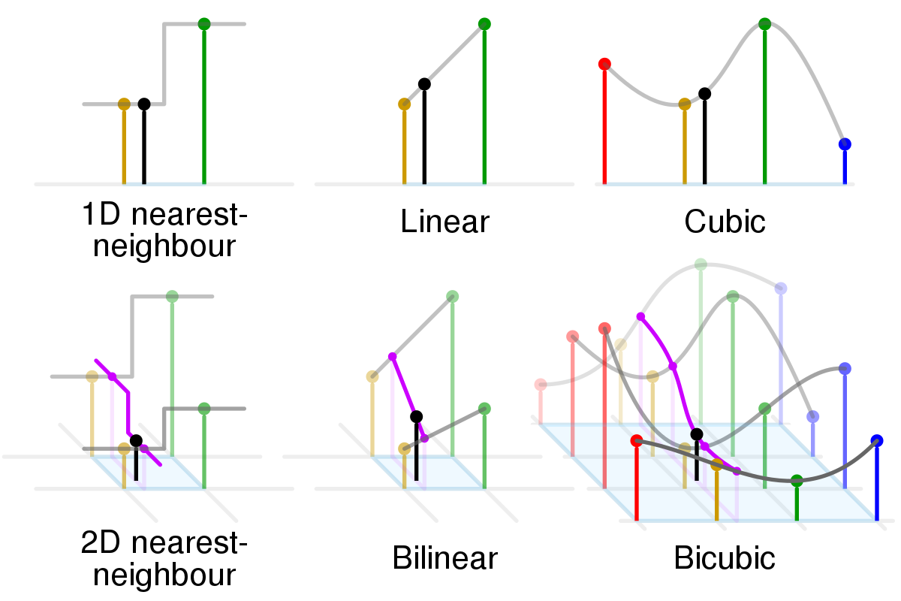
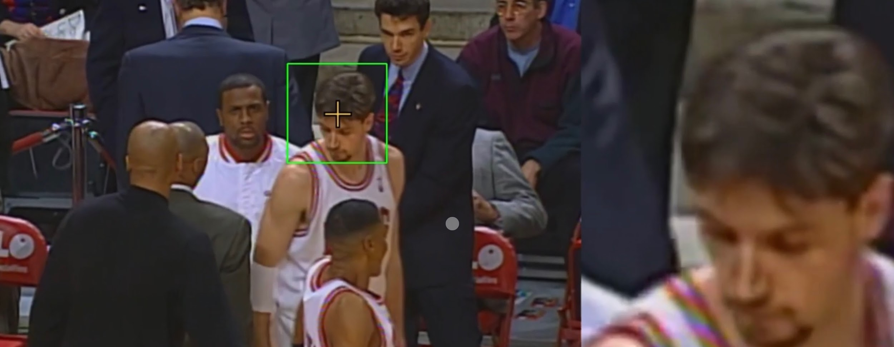
Technical Background
Bicubic++ leads in real-time super-resolution technology [1], efficiently enhancing image quality from low-resolution inputs.
Higher resolution models like SwiftSRGAN [2] are too slow for real time.
Our adaptive Region-of-Interest (ROI) strategy selectively identifies different ROI sizes, maintaining high resolution in targeted areas without full-frame processing.
Notes:
Dario

Slide 6
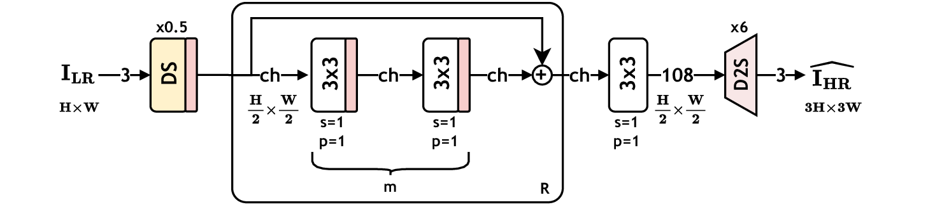
Methodology
Conv2D Transpose
Integration of Bicubic Plus Plus Model: Optimized for speed and quality with efficient layers and PixelShuffle for enhanced upscaling.
Utilization PyTorch and CUDA: Employing GPU acceleration to boost processing speeds for real-time super-resolution.
Use of Pretrained Weights: Enables effective generalization across video contents, bypassing extensive training.
PixelShuffle
General network structure of Bicubic++: DS denotes the downscaling sub-network and D2S is the depth-to-space layer. Residual addition blocks are shown by R, and the number of convolutional layers inside R is m. s and p denote the stride and padding of the convolutional layers, respectively. “ch” is the global channel number parameter. In the final proposed model, R=1, m=2, ch=32, and DS is a 3×3 convolutional layer with s=2, p=1.

Slide 7
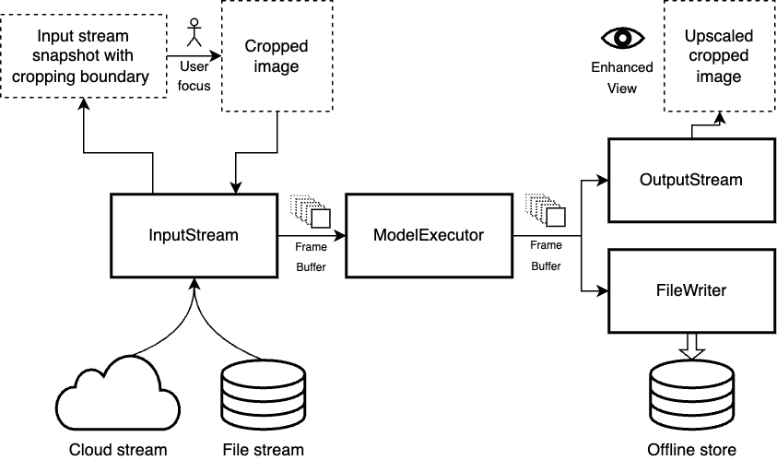
Pipeline Architecture
Pipeline Structure and Communication: Divided into four main blocks, the pipeline uses FrameBuffer to facilitate communication between these components to manage processing fluctuations and handling data transfers across hardware resources.
Parallel Pipeline Components:
InputStream: Handles displaying incoming video stream, and capturing user’s ROI.
ModelExecutor: Uses a machine learning model to upscale selected video segments.
OutputStream: Displays the upscaled video frames with stream synchronization.
FileWriter: Writes the upscaled frames to persistent storage for future use.

Slide 8
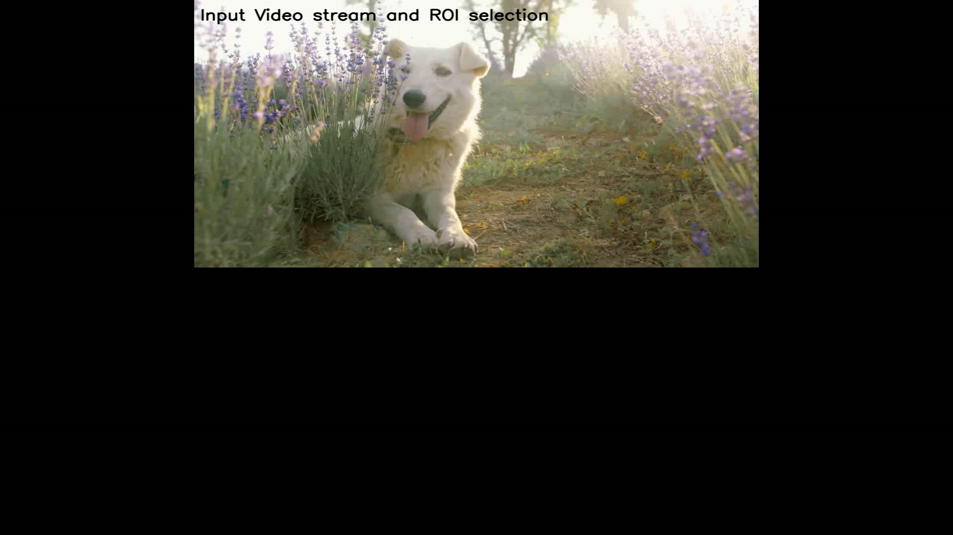
Demo: Quality Performance

Slide 9
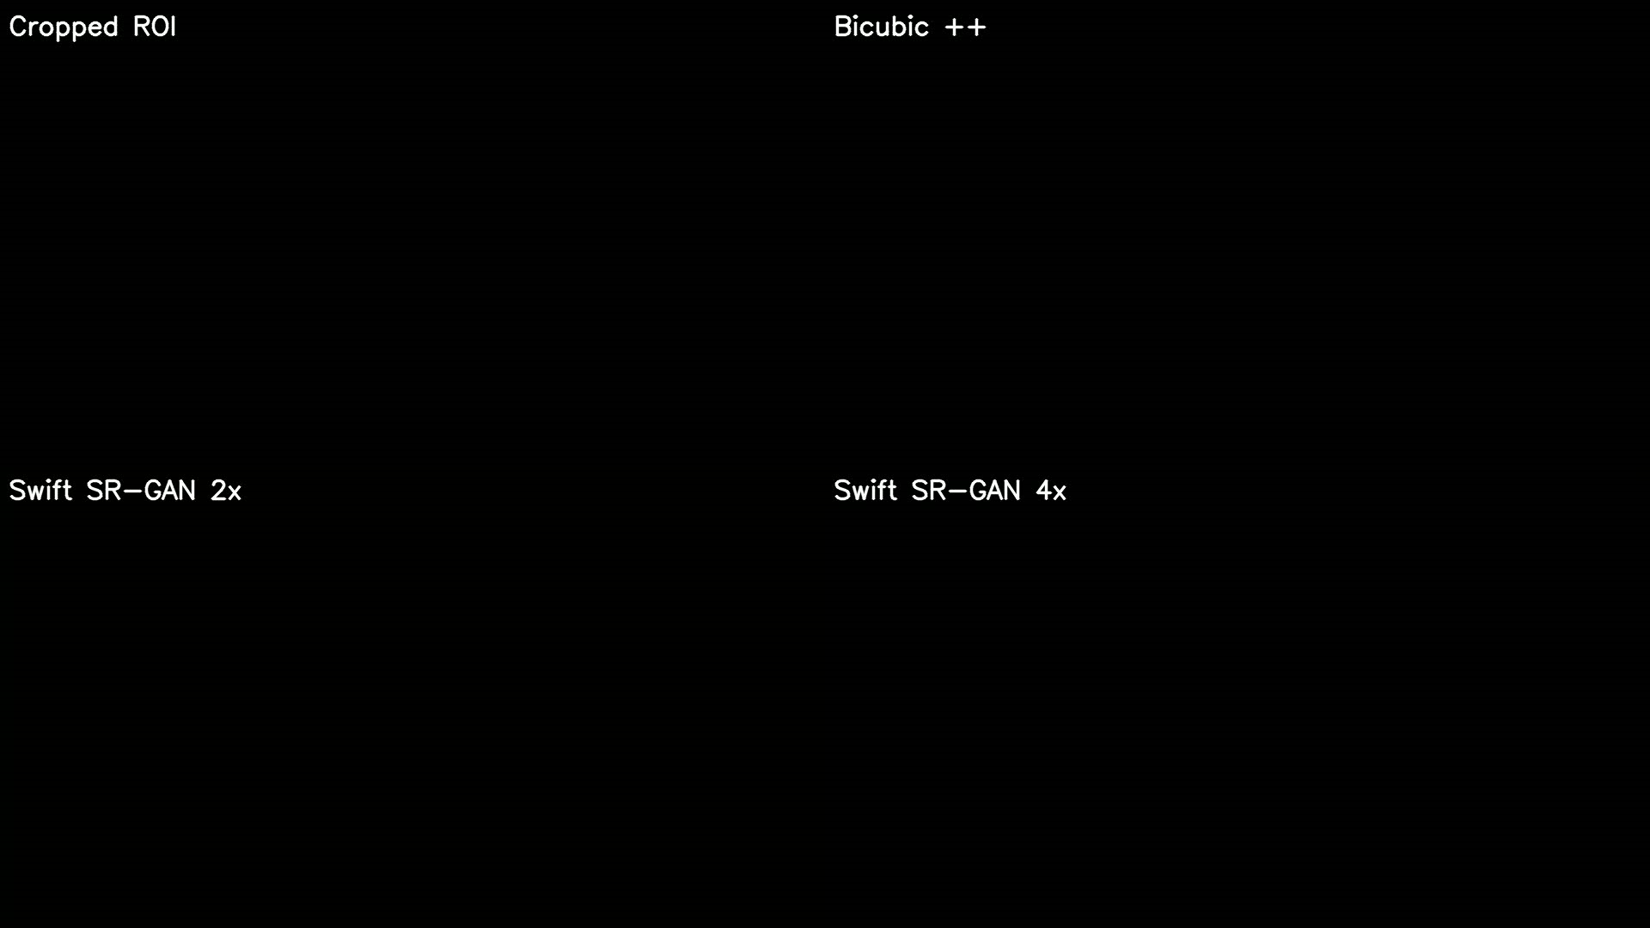
Demo: Latency Performance

Slide 10
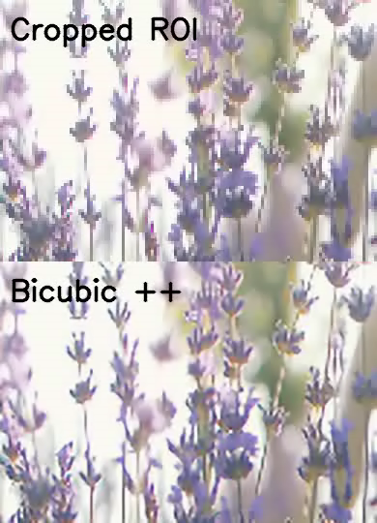
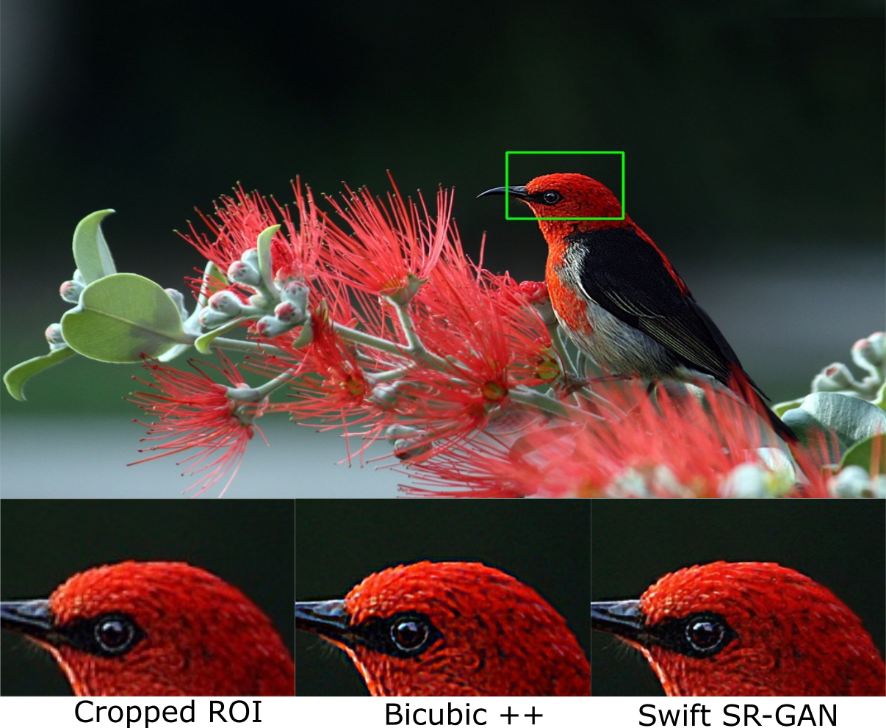
Analysis
Notes:
Results (1/2 minute):
- Upscaling Challenges Addressed:
Successfully upscaled from 360p to 1080p and from 720p to 4K resolutions.
Performance Metrics:
Achieved rapid frame processing speed of 4.4 milliseconds per frame.
Quality validated through high SSIM and PSNR values, ensuring structural integrity and image quality.
Video Duration Integrity:
Maintained original video lengths during upscaling, showcasing the model's precision and balance between speed and enhancement
- Discuss how your solution addresses the challenges identified earlier.
- If applicable, provide a live demonstration or showcase pre-recorded demo videos of your system in action.

Slide 11
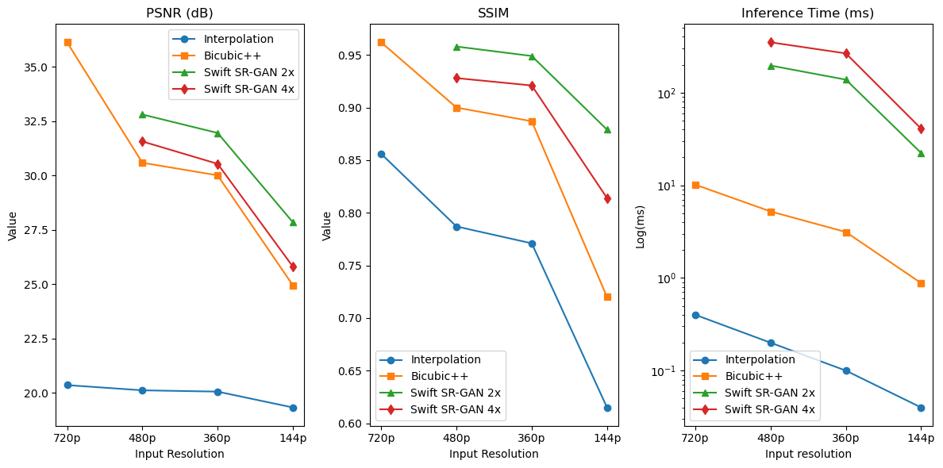
Results: Model Performance Comparison

Slide 12
Next Steps
Native Parallelism: Overcome the issues of GIL
Functional Testing: We will conduct comprehensive tests to verify that each part of the system works correctly together, addressing any issues as they arise.
Project Setup Guide and Quickstart: Open source publishing
Webpage creation and Demos
Notes:
Conclusion (1 minute):
- Summarize the key points of your presentation.
- Reflect on the significance of your findings and their implications.
- Discuss any limitations or future directions for your project.

Slide 13
Future Scope
Artifacts in Upscaling lossy streams - Use of Better and Larger models (trading off inference time for upscaling quality - running multiple instances and executed via a multiplexing queue): (Things like Optical flow)
Focus window synchronization with wider window upscaling for smooth transitioning of ROI
CUDA streams integration for parallelizing kernel execution and data transfer at the GPU level.

Slide 14
References
Videos
Pexels
Blender archive
Images
https://encrypted-tbn0.gstatic.com/images?q=tbn:ANd9GcRP13D2be53h__Ic58ECDHoQ7sC603mT5DJiw&s
https://ferrumhealth.com/wp-content/uploads/2023/08/shutterstock_1181851309-1024x683.jpg
https://images.businessnewsdaily.com/app/uploads/2022/04/04081421/1554239840.jpeg
Publications
Bilecen, Bahri Batuhan, and Mustafa Ayazoglu. "Bicubic++: Slim, slimmer, slimmest-designing an industry-grade super-resolution network." Proceedings of the IEEE/CVF Conference on Computer Vision and Pattern Recognition. 2023.
Krishnan, Koushik Sivarama, and Karthik Sivarama Krishnan. "SwiftSRGAN-Rethinking super-resolution for efficient and real-time inference." 2021 International Conference on Intelligent Cybernetics Technology & Applications (ICICyTA). IEEE, 2021.

Slide 15
Questions?
(Next group to use this time to setup)
Notes:
Q&A (2 minutes):
- After your presentation, the audience will have the opportunity to ask questions.
- The next group will use this time to setup.

